Slide 1
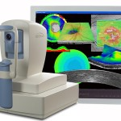
Clinical Applications of Optical Coherence Tomography in Ophthalmology
Dr. PANG SAMORN

Slide 2
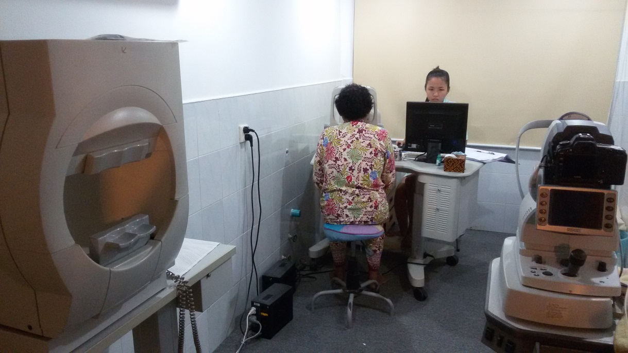
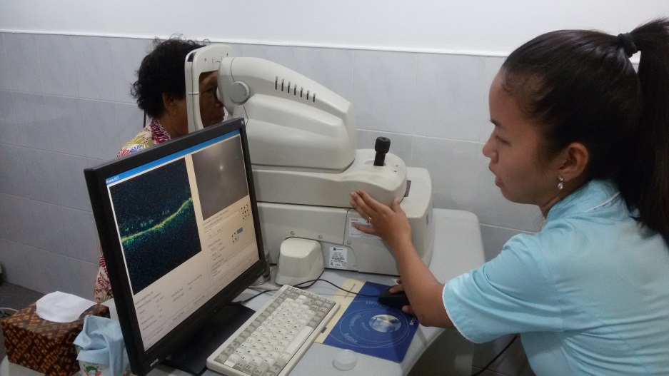
In Ophthalmology
one who relies on OCT alone is little wise,……
one who relies on OCT & FA is wiser,…
one who relies on OCT, FA, & clinical examination is the wisest……

Slide 3
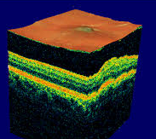
OCT
OCT was first reported in 1991
Different color codes: white, red, orange, yellow, green, blue, and black.
White is thickest scanned retina: > 470y
black is thinnest scanned retina: < 150 y

Slide 4
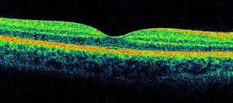
Normal values of OCT
Vitre-oretinal interface ↔ Ant RPE: 200 – 275y
Foveal: 170 –190y
Peri. retina: 220 – 280y
RNFL: 270 microns

Slide 6
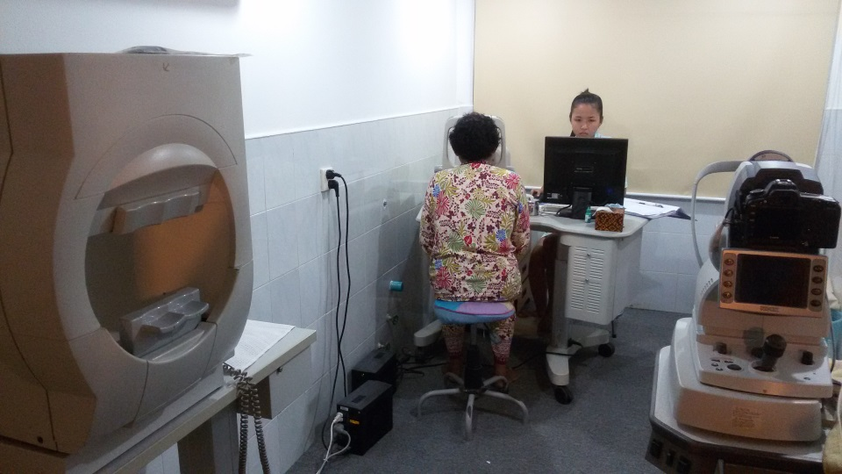
OCT
Remind: fundus photos & FA before OCT.
OCT: cannot be & should not be interpreted independently vis-à-vis any ocular disease.
Also, it should never be taken as the only criteria for the diagnosis or treatment.

Slide 7
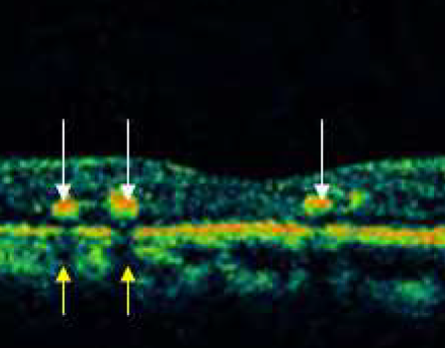
Hyper-reflective scans
Hyporeflective scans
Drusen
ARMD
CNVM lesions
RNFL
ILM
RPE
PED
Ant face of hegie
Disciform scars
Hard Exudates
Epiretinal membrane
Retinal atrophy
Intraretinal/subretinal fluid

Slide 8
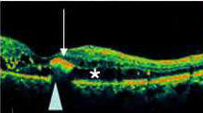
Yes shadows:Superficial layers
No shadows
Serous collections
Scanty hemorrhage
Normal retinal blood vessels
Dense collection of blood
Cotton wool exudates
Deep layers
HE (lipoproteins)
RPE hyperplasia
Intraocular FB
Dense pigmented scars
Choroidal nevi
Thick subretinal NV membrane

Slide 9
Retinal Layer Defect

Slide 10
1. Superficial lesions
Epi-retinal & vitreal membranes.

Slide 11
1. Superficial lesions
Epi-retinal & vitreal membranes.
Exudates & hgie

Slide 12
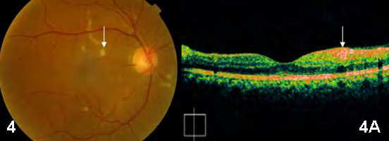
1. Superficial lesions
Epi-retinal & vitreal membranes
Exudates & hgie
CWS

Slide 13
2. Intra-retinal lesions
Hgie: OCT should be set to a maximum resolution to elicit good scans.
After Avastin inject

Slide 14
2. Intra-retinal lesions
Hgie
HE: lipoproteins located at the margin between healthy & edematous retina.
DR

Slide 15
2. Intra-retinal lesions
Hgie
HE
Retinal fibrosis + disciform degenerative scars
sequel to AMD

Slide 16
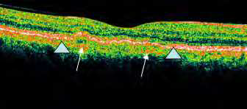
3. Deep lesions
Drusen.
drusen under the RPE

Slide 17
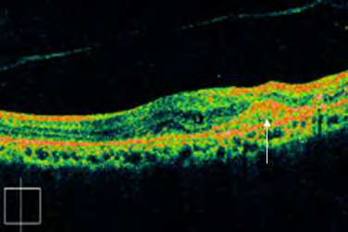
3. Deep lesions
Drusen.
RPE hyperplasia.
ARMD

Slide 18
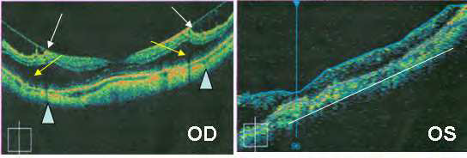
3. Deep lesions
Drusen.
RPE hyperplasia.
Intra-retinal & sub-retinal NV membrane
CNVM with vitreo-macular traction & retinoschisis
scarred CNVM (along line).

Slide 19
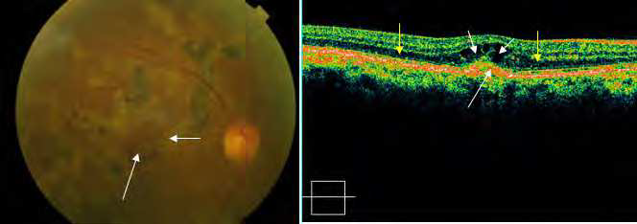
3. Deep lesions
Drusen.
RPE hyperplasia.
Intra-retinal & sub-retinal NV membranes.
Scarring: choroiditis, trauma or laser
CNVM scar (long white arrow) after PDT and four injections of ranibizumab.

Slide 20
3. Deep lesions
Drusen.
RPE hyperplasia.
Intraretinal & sub-retinal NV membranes.
Scarring: choroiditis, trauma or laser
Hyperpigmented choroidal nevi.

Slide 21
4. Lesions causing hypo or low reflectivity
Atrophic RPE (loss of pigment).
Cystic or pseudocystic: serous fluid.

Slide 22
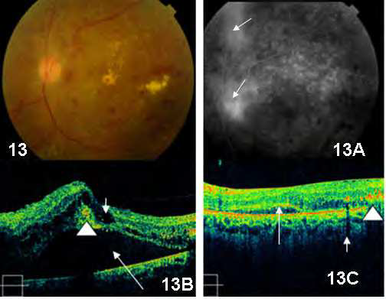
2.5 Lesions causing hypo or low reflectivity
Atrophic RPE (loss of pigment).
Cystic or pseudocystic: serous fluid.
Cystoid edema, serous RD and PED (dark & empty space)
received intravitreal
injection triamcinolone and laser.

Slide 23
Clinical applications of OCT in vitreo-retinal disorders

Slide 24
1. Intra-retinal fluid collections
Retinal edema
56 ys, DM. OCT shows retinal edema with an
intra retinal cyst (asterisk). There is a small collection of subfoveal fluid (white arrow).

Slide 25
1. Intra-retinal fluid collections
Cystoid macular edema
15: Post-operative chronic cystoid macular edema. 738 microns.
15A: FA: shows classical cystoid macular edema.
15B: intravitreal triamcinolone, and one year later: 339 microns with few persisting cystoid spaces , subfoveal fluid has disappeared.

Slide 26
1. Intra-retinal fluid collections
Serous retinal detachment: fluid within retinal layers or between RPE & Sensory retina
Color fundus: exudates and macular edema.
FA: shows prior laser marks and bilateral non-perfusion areas
OCT: intraretinal fluid cysts

Slide 27
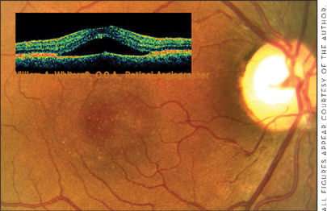
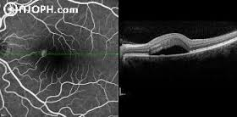
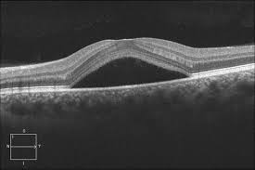
2. Sub-retinal fluid collections
Serous retinal detachment: CSCR, Serous fluid causes elevation of
the sensory retina.

Slide 28
Role of OCT in CSCR
Presence of subretinal fluid/PED.
monitoring of subretinal fluid.
Different between CSCR & occult CNVM.
Localization of leakage points

Slide 29
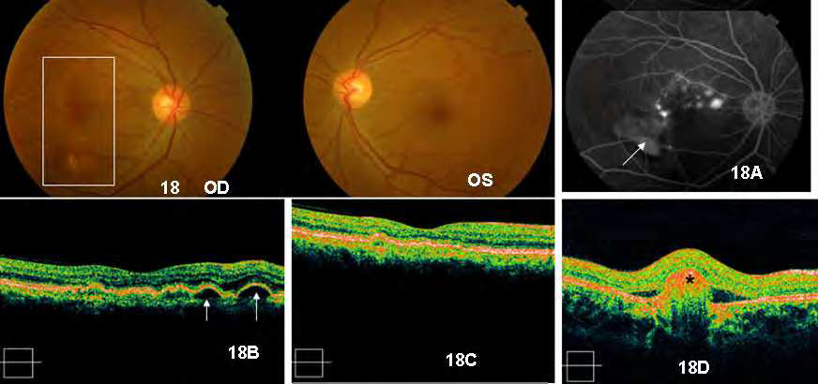
2. Sub-retinal fluid collections
PED
resolution of the PED after anti-VEGF treatment

Slide 30
2. Sub-retinal fluid collections
PED

Slide 31
Common causes of RPE detachment include:
CSCR,
ARMD with or without sub-retinal NV,
melanomas
choroidal tumors

Slide 32
3. Epiretinal membrane (ERM)
Only 42% detected by OCT. But newer high-resolution OCT scans may show improve

Slide 33
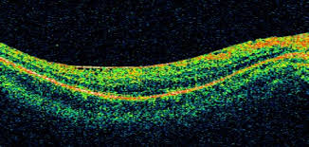
Causes of ERMs: vascular, uveitis, trauma, idio
best seen by OCT when there is some gap between the membrane and the inner retinal tissue.
# tightly adherent to the retinal tissue may not be detected by OCT.

Slide 34
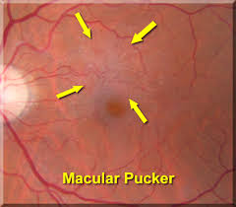
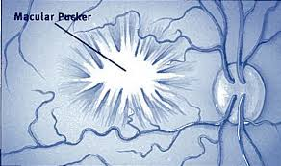
3. Macular pucker
Altered vascular architecture.
Macular edema.
May evolve into macular pseudoholes.
Visual distortion and decreased vision.
FA may show macular leakage.

Slide 35
3. Macular pucker
Altered vascular architecture.
Macular edema.
May evolve into macular pseudoholes.
Visual distortion and decreased vision.
FA may show macular leakage.

Slide 36
4. Vitreo-macular traction
Clinical features
Distortion macular
Antero-post & tangential tractional forces applied to the macula.
Intraretinal edema with or without subretinal fluid.

Slide 37
diabetic and hypertensive patient having a constant vitreo-macular traction (arrowhead) causing cystoid macular edema

Slide 38
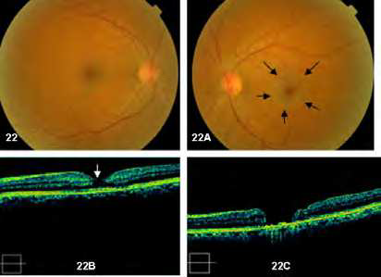
5. Macular pseudoholes and lamellar holes
Pseudoholes occur in presence of epiretinal membranes with central defects.

Slide 39
5. Macular pseudoholes and lamellar holes
Pseudoholes occur in presence of epiretinal membranes with central defects.

Slide 40
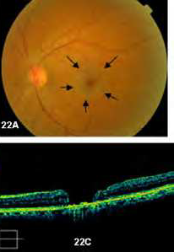

Slide 41
6. OCT in diabetic retinopathy
Cotton-wool spots
Hard exudates
Retinal hemorrhages
Fibrous tissue
Retinal edema

Slide 43
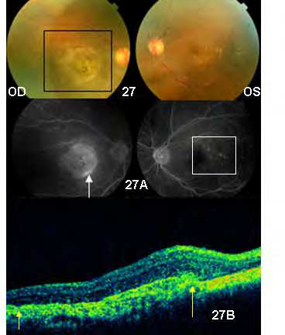
7. Wet ARMD
serous elevation of RPE & neurosensory retina,
hgie under RPE
Sub-retinal hgie.

Slide 45
8. OCT applications in glaucoma

Slide 49
Macular segmentation feature of Cirrus HD-OCT shows a patient with an RNFL defect inferotemporally in the left eye.

Slide 50
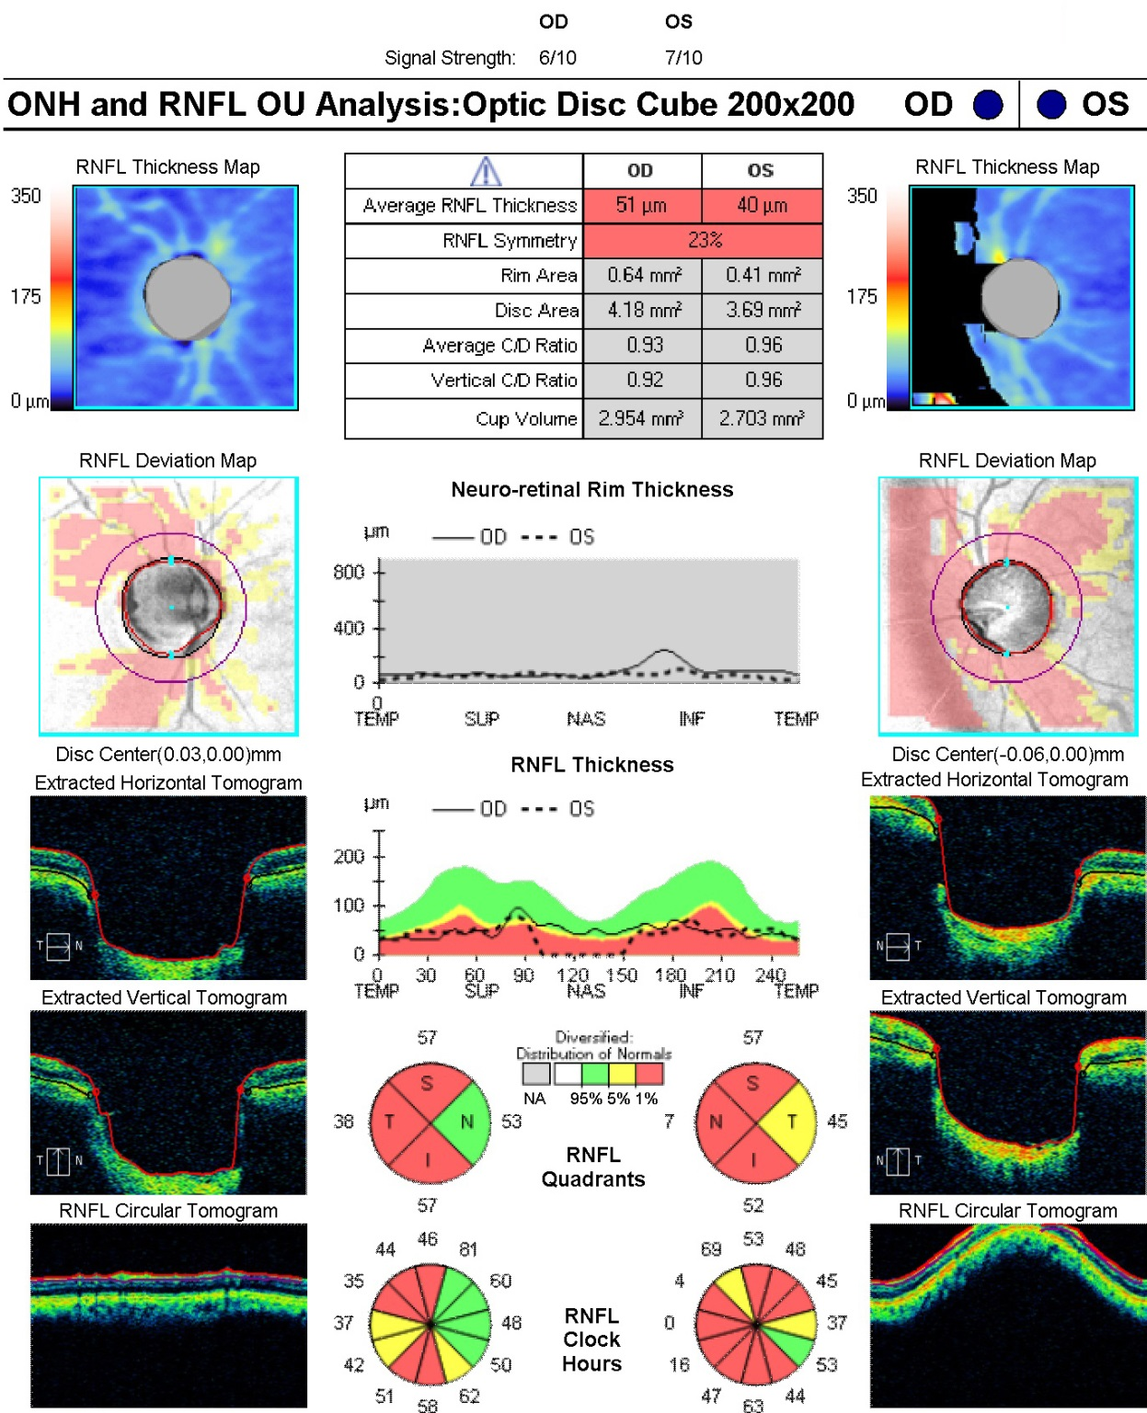

Slide 51
God Bless…

